Slide 1
Cataloging tools
By Dejah Rubel
Duran Duran Album Art by Patrick Nagel c1981.

Slide 2
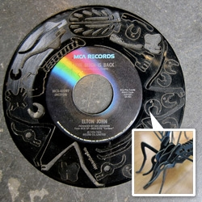
Overview
Glossaries
MARC Basics
Creating Cutter Numbers
NACO/SACO Authority Databases
FRBR
Album Cataloging Workflow
Future Training
Laser Cut Vinyl Record Puzzle
http://www.notcot.org/post/39132/Record-Monsters-are-Laser-Cut-Vinyl-Record-Puzzles-LPs-/

Slide 3
Glossaries
Library Terminology Informally Explained by W3C Semantic Web
https://www.w3.org/2001/sw/wiki/Library_terminology_informally_explained
Cataloging Glossary by University of Southern Mississippi Libraries Technical Services
http://www.lib.usm.edu/techserv/cat/glossary.html
Confused? Ask!
Found but no artist cited at:
http://www.stereo2go.com/topic/incredible-cassette-tape-art

Slide 4
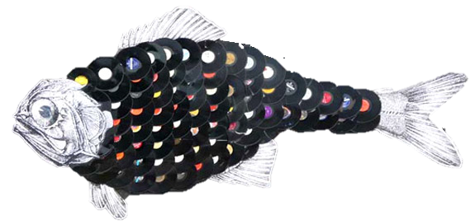
Marc basics
Library Boot Camp: Basic Cataloging, Part 1 Slideshow (Slides 37-53)
by Denise Garofalo, Librarian at Mount Saint Mary College, State Univeristy of New York at Albany
http://www.slideshare.net/denisegaro/library-boot-camp-basic-cataloging-part-1
Found but no artist cited at: https://artchats-2d-3d-design.wikispaces.com/Wiki+assignment+2

Slide 5
Creating cutter numbers
General Anatomy
Class and Subclass
Range
Cutter Number 1
Cutter Number 2
Date
Understanding Library Call Numbers by Charlotte Christian College and Theological Seminary at: http://www.charlottechristian.edu/understanding-library-calling-numbers.php

Slide 6
Creating cutter numbers
Unique Situations
Library of Congress Call Numbers: A Guide for Non-Catalogers Who Suddenly Find Themselves with a Cataloging Job by Angela Kroeger (Slides 14-17)
http://www.slideshare.net/akroeger/kroeger-lcclassification
“Blow Out Girl” wall art hanging by Blackberry Hill Designs at: https://www.artfire.com/ext/shop/product_view/blackberryhilldesigns/4880368/recycled_vinyl_record_blow_out_girl_wall_art_hanging/handmade/earth_friendly/upcycled

Slide 7
Creating cutter numbers
Method
Step 1: Find the main entry
Step 2: Use either the LOC Cutter Table http://www.loc.gov/aba/pcc/053/table.html
OR the Cutter Number Calculator http://calculate.alptown.com/ to generate at least 4 digits
Step 3: Search Sierra by the class/subclass and range number
Step 4: Using the least number of digits (minimum 2) check that your cutter number will be unique
Step 5: Add to record and append date

Slide 8
Creating cutter numbers
Music Call Numbers
The majority of our albums will have two cutter numbers.
The first will be for the main entry and the second will be based off the work title.
How to Read LC Call Numbers for Music Scores at Reed Library by State University of New York at Fredonia at: http://www.fredonia.edu/library/music/pdfs/LC_Call_Numbers.pdf

Slide 9
NACO/SACO Authority databases
Searching the Online Interface
Most of the time, you will be searching using Connexion, but if it doesn’t return an authority record, you will have to search the web interface and correct the name or subject until it is controlled.
Search the online LOC authorities database: http://authorities.loc.gov/
Step 1: Click “Search Authorities”
Step 2: Select either subject or name authority headings
Note: Search by title or name/title to check uniform titles (X30) and series titles (4XX)
Step 3: Search as the name or subject would appear, i.e. last name, first name (X00s),
name in direct order (X10s), and omit subfields (X50s)
Step 4: Click red “Authorized Heading” or “References” button next to the appropriate name
You may have to “play around” with using initials, dates, etc. to find the correct name

Slide 10
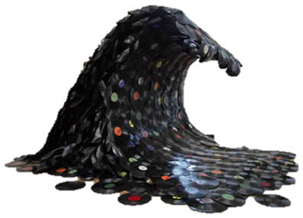
NACO/SACO Authority databases
Searching the Online Interface
Step 5: If you found an “Authorized Heading” button you should be able to click through to an authority record link even if the name looks different.
If you found a “References” button you will have to click twice on the “Authority Record” link to get to the same authority record.
Pick someone famous or a topic you think should be in the LCSH and practice.
Did you find the right person or subject yet?
The database times out very quickly, so get used to frequently having
to conduct “New Searches” instead of hitting the back button.

Slide 11
NACO/SACO Authority databases
So what do all those MARC fields mean?
Old Fields
053 = LCCN classes and ranges
1XX = Authorized headings – USE!!
360 = Explanation of the relationship between this authority and the 5XX fields
4XX = See from headings (Unauthorized) – NEVER USE
5XX = See also from headings
For subject headings, |w g = more general |w = nne = more narrow
6XX = Notes – Can help clarify identity as well as describe a subject more thoroughly
Remember! You can only apply an authority with the extension given.
For example, a 150 heading can only be applied as a X50 field.
Vinyl Record Silhouette by Carlos Aires at: http://weburbanist.com/2009/08/03/from-vinyl-to-divinyl-12-groovy-ways-to-upcycle-vinyl-records/

Slide 12
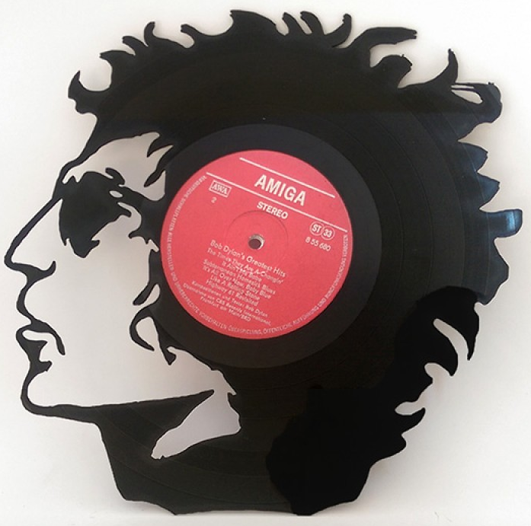
NACO/SACO Authority databases
So what do all those MARC fields mean?
More fields means more opportunities to match the right creator with the right work!
Bob Dylan recycled artwork by db-steampunk at: http://www.db-steampunk.com/Bob%20Dylan-vinyl-record-art-lp

Slide 13
NACO/SACO Authority databases
And how do we express these relationships in a bibliographic record?
When using authorized names, always append |e with the relator term.
Subfield e (relator term) is preferred to subfield 4 (relator code) according to RDA Best Practices for Music Cataloging
MARC Code List for Relators (Term Order): https://www.loc.gov/marc/relators/relaterm.html
Common terms: performer, broadcaster, composer, conductor, creator, distributor, instrumentalist, lyricist, recording engineer
Less common terms: adapter, arranger, cover designer, host, interviewee, interviewer, musical director, musician, producer, radio director, radio producer, recordist, sound designer
Black vinyl road LP art (Sean Somer aka Dia) at: http://www.artbusiness.com/1open/050808.html

Slide 14
FRBR Theory
That sounds like lots of work!
Aside from keeping catalogers employed, why would we go to all that trouble?
GOAL One Work to Rule Them All
One Work to Find Them
One Work to Bring Them All
And in the Discovery Layer Bind Them
Maybe an example will help…

Slide 15
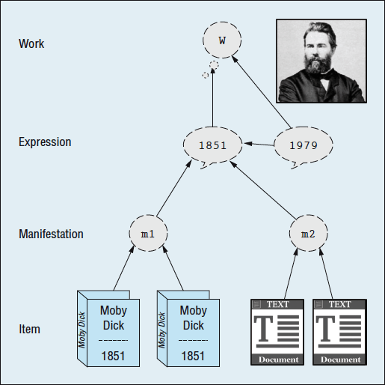
FRBR example
Moby Dick
Work = Concept of Moby Dick
Captain Ahab on the Pequod chasing a white whale as recounted by Ishmael
Expression = Variation of the concept
Revised publications, different adaptations or genres, etc.
Play or film version with Patrick Stewart as Ahab
Manifestation = Tangible version of the expression
Patrick Stewart film version on DVD
Item = The single unique copy you own

Slide 16
Album cataloging workflow
Step 1: Inventory = DONE
Step 2: Retrieve OCLC Record via Connexion
Step 3: Edit Master Record Metadata
Step 4: Replace Record and Set Holdings
Step 5: Export Record
Step 6: Merge Local Catalog Records in Sierra
Step 7: Set aside for Labeling and Shelving
If anything is too difficult, set it aside.

Slide 17
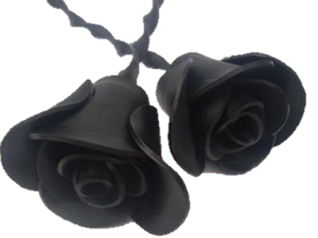
Future training
Week of July 11th 2016
Sound Recordings: Album anatomy, terminology, and project workflow
Week of July 18th 2016
Album Cataloging: Field by field break-down of the metadata specifications
July 22nd 2016
Cataloging Party!
Life size vinyl record roses by Janet Marquez at: http://www.festivals-and-shows.com/jebyja-upcycled-vinyl-record-creations-phoenix-az.html

