Slide 1
Sound Recordings Training
Vinyl Albums
By Dejah Rubel

Slide 2
Overview
Manufacture
Album Anatomy
Album Art
Unusual Formats (Just for Fun!)
Industry Trends
Project Workflow

Slide 3
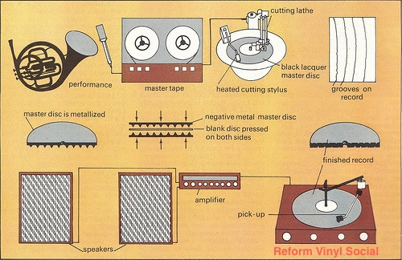
Manufacture

Slide 4
Manufacture
A Brief Video History of Record Manufacturing: Early Vinyl Manufacturing 1960s (6 mins)
http://www.thevinylfactory.com/vinyl-factory-releases/a-brief-video-history-of-record-manufacturing/
How to Make a Vinyl Record
https://www.theguardian.com/money/2010/jun/26/disappearing-acts-making-vinyl-records
The Physics of Vinyl (15 mins)
http://www.thevinylfactory.com/vinyl-factory-news/the-physics-of-vinyl-listen-to-podcast-explaining-the-science-behind-how-vinyl-works/
The History of Recorded Music from Phonographs to Records to iPods, with a Few Hiccups Along the Way
http://www.popsci.com/gadgets/article/2011-10/archive-gallery-history-recorded-music?image=0

Slide 5
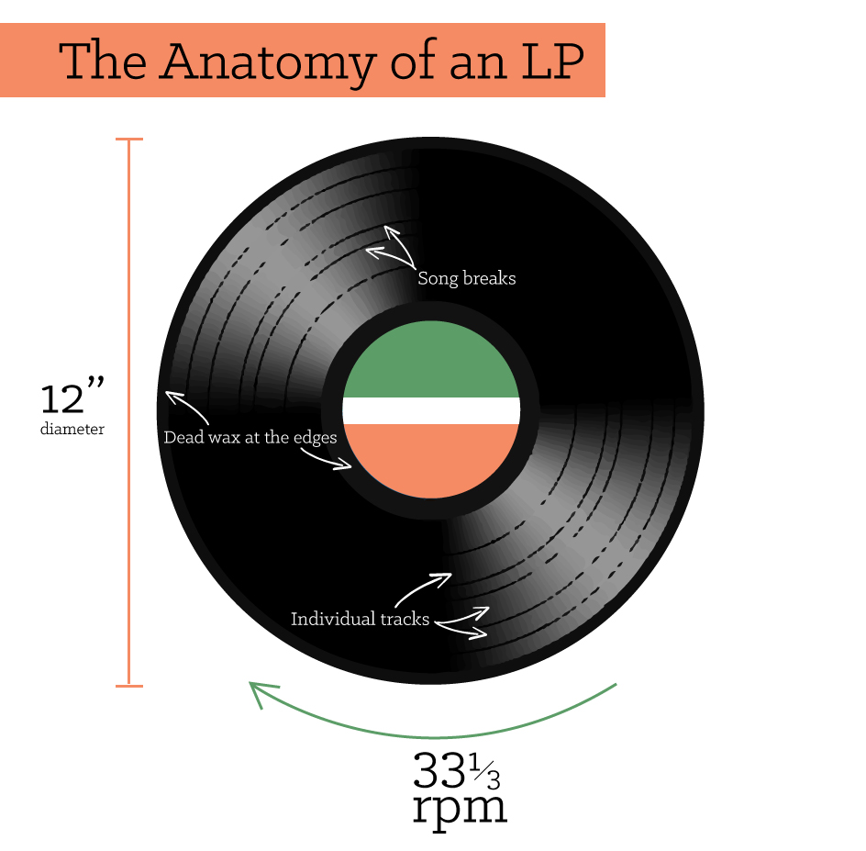
Album Anatomy
Album = a collection of recordings issued as a single item (Work)
LP = a long playing record (40+ mins) at 33 1/3 rpm
EP = an extended play record often featuring one major single with 1-5 additional songs
Single = a record with 1-2 songs used primarily for promotion, e.g. 45s
Cardboard jacket or outer sleeve
Paper jacket or inner sleeve
Handling and storing

Slide 6
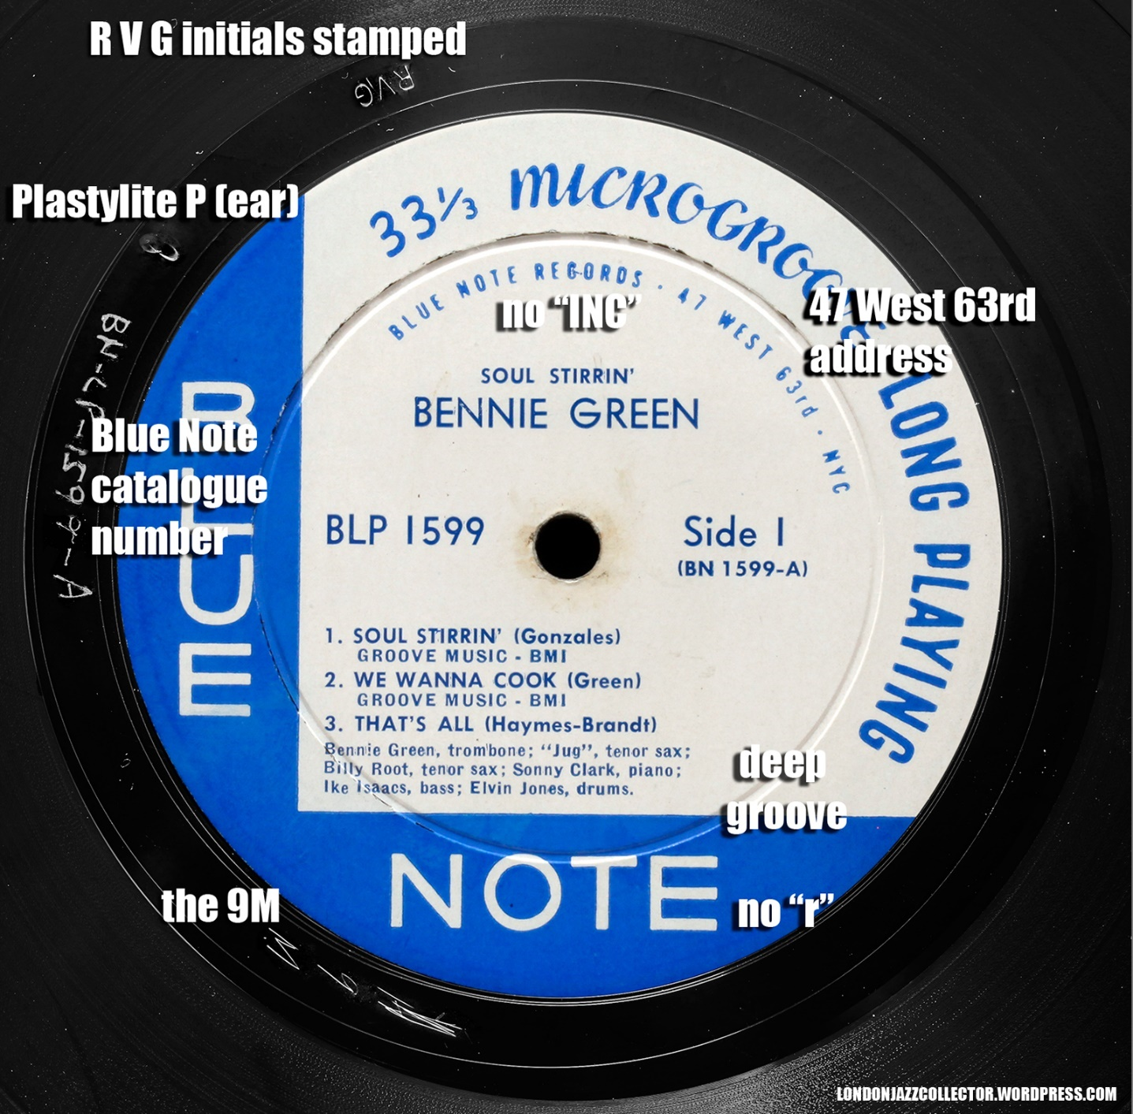
Album Anatomy
Issue number = Also called the catalog or label number, this is printed on the album’s paper label and is assigned by the record label
Matrix number = Also called the manufacturer, stamper, or pressing number, this is pressed into the inner rim of the vinyl record and corresponds to the stamper used to manufacture it
From Blue Note Records: guide to the labels by The London Jazz Collector at https://londonjazzcollector.wordpress.com/record-labels-guide/labelography-2/the-blue-note-labels/

Slide 7
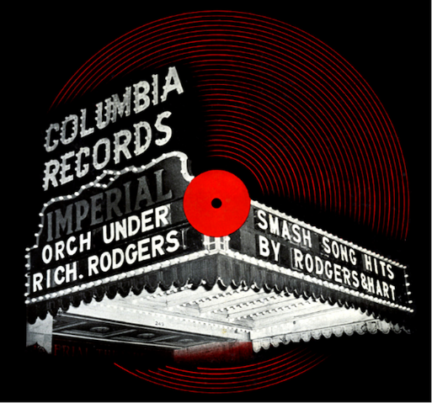
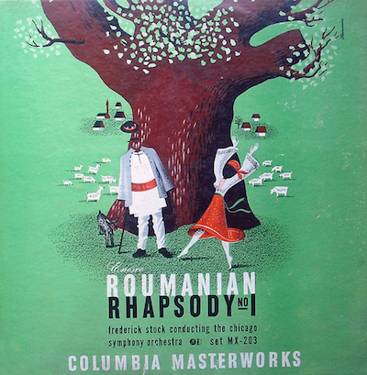
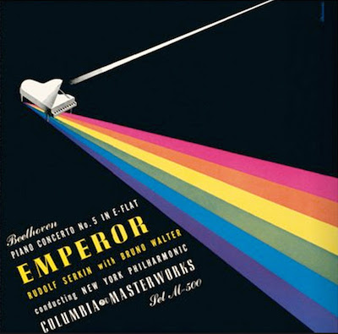
Album Art
Includes inner and outer sleeve art as well as any enclosures
First illustrated album sleeve by Albert Steinweiss for Rogers & Hart (1940)
Steinweiss also invents the cardboard jacket for microgroove (33 1/3 rpm) recordings
Album art discovered to significantly increase classical and jazz sales
Alex Steinweiss: The Story of the World’s First Record Sleeve Artist
http://www.thevinylfactory.com/vinyl-factory-releases/alex-steinweiss-the-story-of-the-worlds-first-record-sleeve-artist

Slide 8
Unusual Formats
Multiple groove or puzzle records
Includes novelties like horse race games, MAD magazine’s multiple ending story, and the Cheech and Chong Ripped You Off album
Most well-known is Monty Python’s Matching Tie and Handkerchief (1973)
Example: 1901 Fortune Telling Record (3.5 mins) https://www.youtube.com/watch?v=MhZQpFKLuEE
Holographic vinyl
http://www.thevinylfactory.com/vinyl-factory-releases/freaky-formats-holographic-vinyl/
Liquid-Filled vinyl
http://www.thevinylfactory.com/vinyl-factory-news/mondo-aliens-soundtrack-liquid-filled-vinyl/

Slide 9
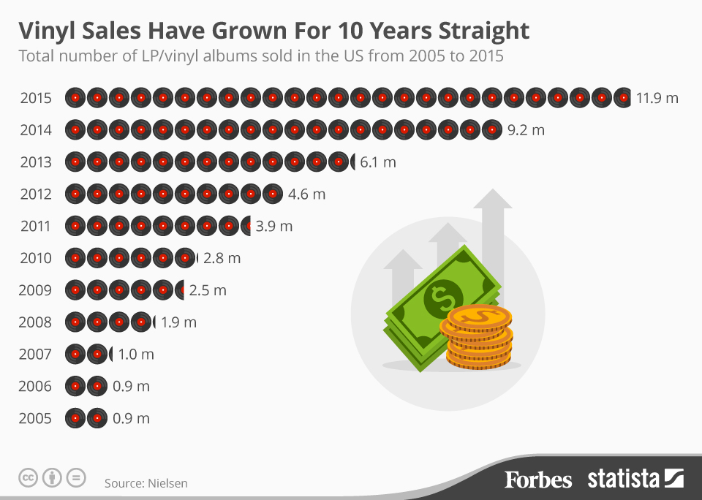
Industry Trends
Steadily increasing sales since the bottom of the bell curve in 2005
New innovations
3-D printed records, etc.

Slide 10
Project Workflow
Starting with the barcoded albums then going by genre starting with popular music, this will be our recursive process through each genre.
Stage 1: Throughput → Catalog as many items as possible by setting aside any that will take more than 5-10 minutes due to their complexity
Stage 2: Clean-Up → Catalog the remainder of the albums except those that will take above 15 minutes, which will be done by the Metadata Librarian
Stage 3: Analysis → Short meeting to discuss what did and did not work
Rehousing can either be done while cataloging or by a student worker in bulk.

